Slide 1
ONLINE SHOPPING ANALYSIS
Project group members:
Nikhil Savant
Sarita Patil
Sumit Yesane
Saroj Chaudhari

Slide 2
Index
Introduction
Problem Statement
System Architecture
Data Cleaning
Data Modeling
Data Visualization
Conclusion
Scope of Project
Reference

Slide 3
Introduction
Every shopping centre is trying to provide personalized and short-time oﬀers for attracting more customers depending upon the day, such that the volume of sales for each item can be predicted for inventory management of the organization.
In this project, we are focusing on online shopping sales prediction or forecasting of an item on customer’s future demand in diﬀerent shopping stores across various locations and products based on the previous records.
Sales are the life of every organization so the forecasting of sales plays an important role in any shopping complex.

Slide 4
Problem Statement
Predicting sales is one of the most important business problems for any retail entity. If a business can predict the how much of it will sell in each month, it can manage its inventory better.
Sales predictions also help in directing the marketing efforts in right direction to increase the chances of sale.

Slide 5
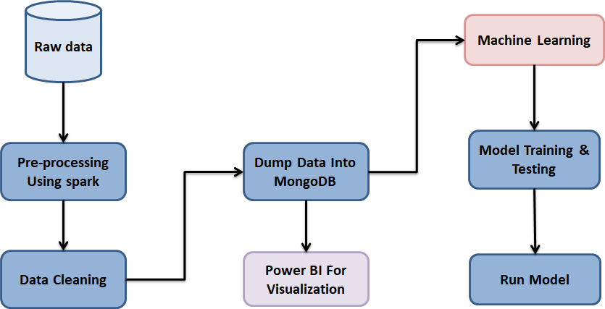
System Architecture

Slide 6
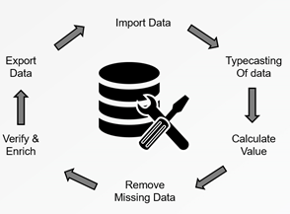
Data Cleaning

Slide 7
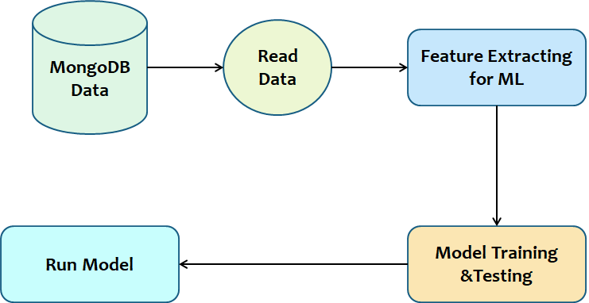
Data Modeling

Slide 8
Algorithms Used
Linear Regression
Ridge Regression
Lasso Regression
Bagging Regression
Random Forest Regression
Bagging Regressor with Linear Regression
Clustering on RFM

Slide 9
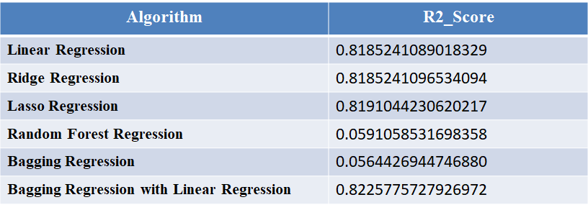
Model Evaluation

Slide 10
K-Means clustering with 4 cluster IDs
Customers with Cluster Id 0 are the customers with average Monetary, Frequency and Recency compared to other customers.
Customers with Cluster Id 1 are frequent buyers.
Customers with Cluster Id 2 are the customers which having high Frequency.
Customers with Cluster Id 3 are frequent buyers with spending average amount

Slide 11
Data Visualization
MongoDB Data
Transform
Formatting
Visualization
Extraction
Load

Slide 12
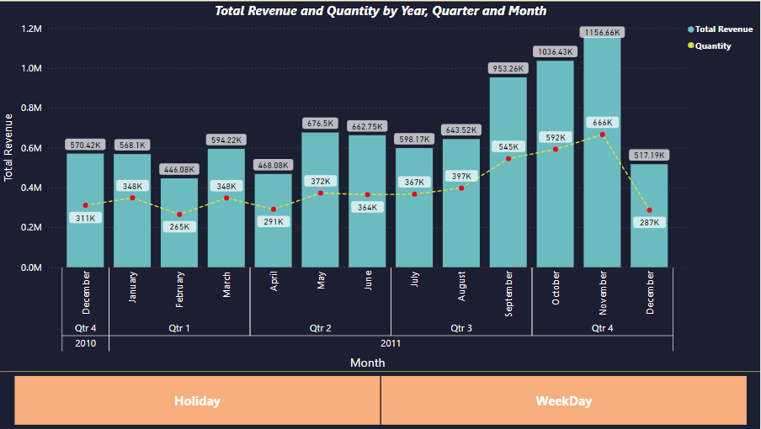

Slide 13
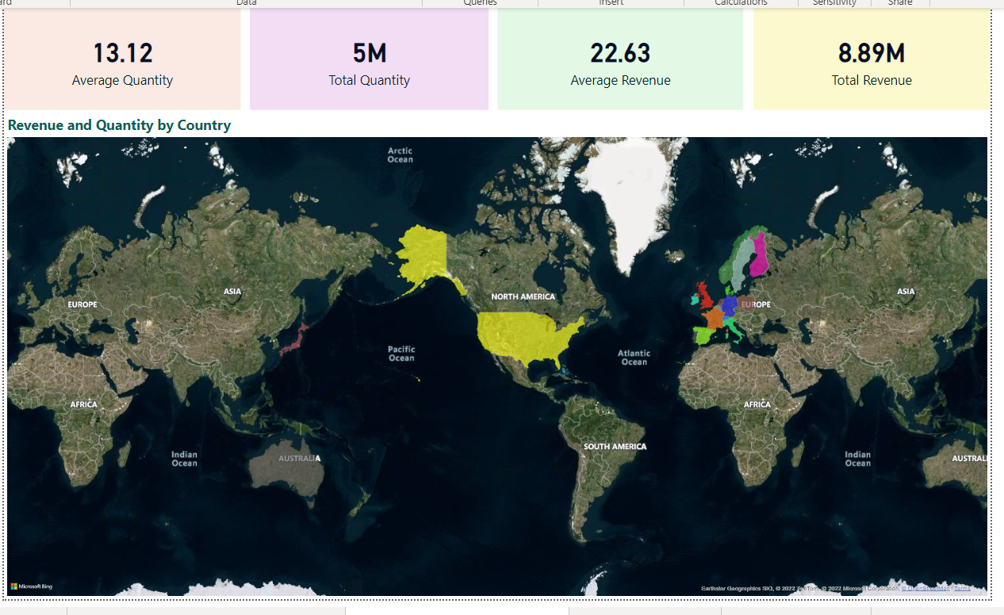

Slide 14
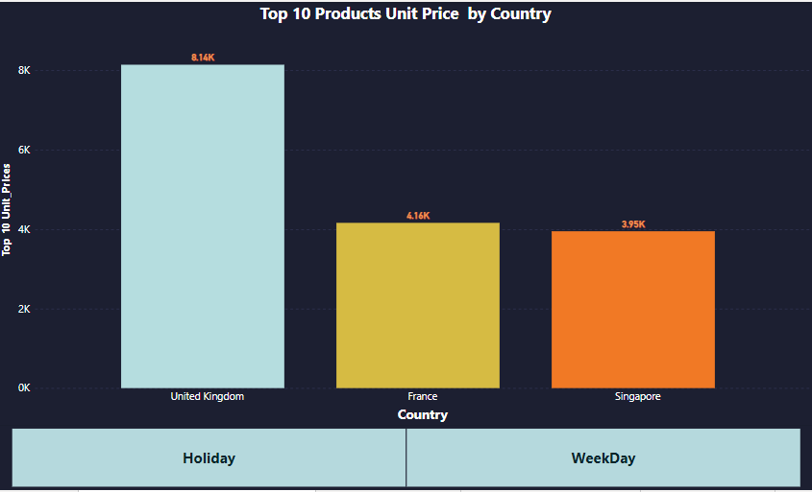

Slide 15
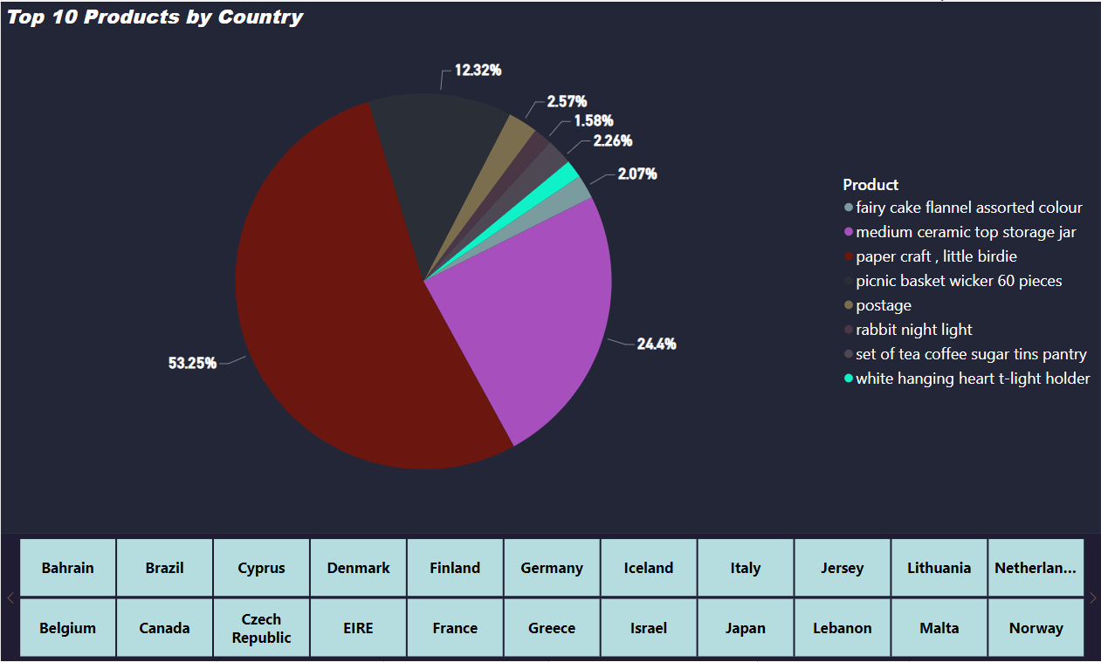

Slide 16
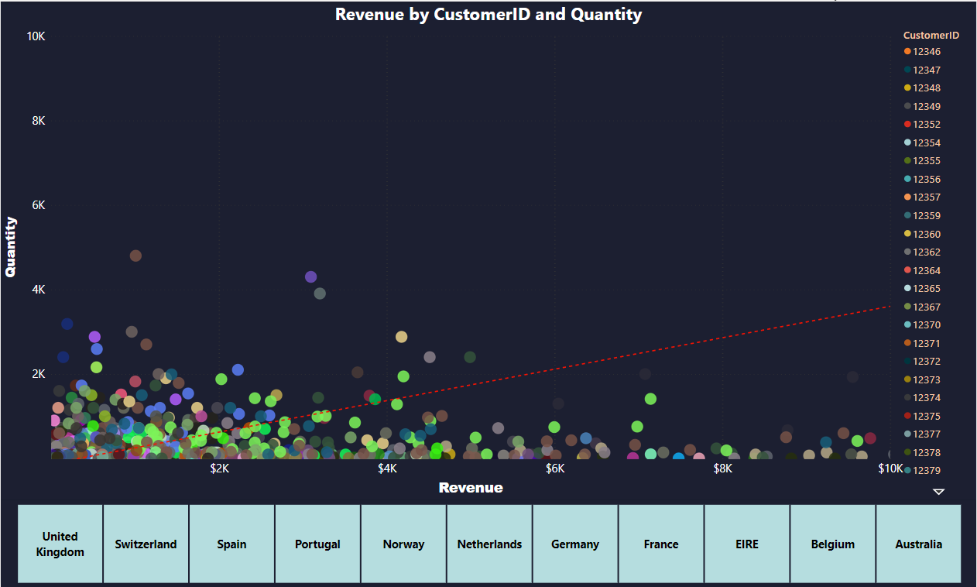

Slide 17
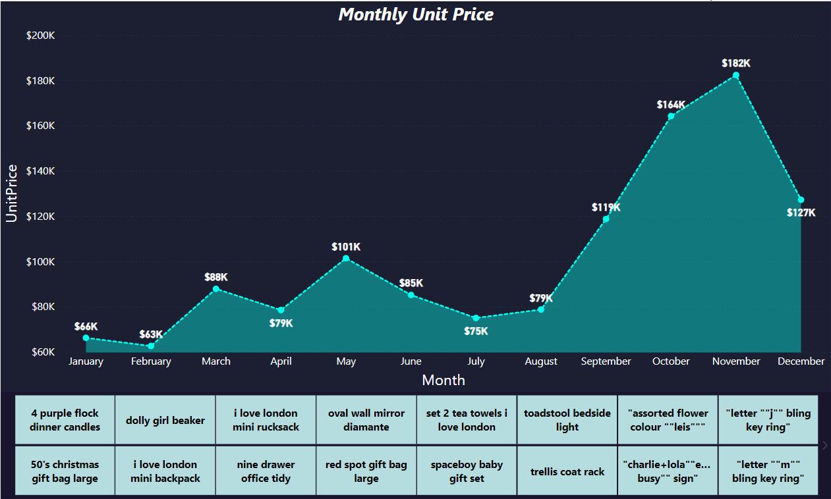

Slide 18
Conclusion
In this project, we have designed a predictive model by modifying bagging regressor with linear regression and performed it on the 2010-11 online retail dataset for predicting sales of the product from different transnational countries.
Bagging regressor with linear regression model produce more accurate prediction compared to other available techniques like linear regression, lasso regression, ridge regression etc. Finally, a comparison of diﬀerent models is summarized in Table 1.
It is also concluded that our model with highest R2_score performs better compared to existing models.

Slide 19
Future Scope
Predict customer churn and suggest ways to prevent the churn
Customer segmentation and buying behavior analysis

Slide 20
Reference
https://archive.ics.uci.edu/ml/datasets/Online%20Retail
https://www.worldpop.org/doi/10.5258/SOTON/WP00689
https://sparkbyexamples.com/pyspark-tutorial/
https://www.analyticsvidhya.com/blog/2021/05/5-regression-algorithms-you-should-know-introductory-guide/

